Slide 1
4 Aug
to
11 Nov
Pray
for
peace

Slide 2
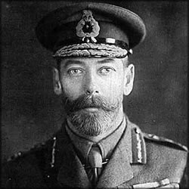
On 4 Aug 1918
George V asked the
nation to pray for peace
100 days later, the war ended.
4 Aug 2018: Remembrance 100

Slide 3
100 Days of Peace and Hope, nationwide:
Prayers, Bible readings, reflections and
peace-making activities
What if Shropshire/Telford joined in?
www.remembrance100.co.uk

Slide 4
Telford & Shropshire woven together
doing alternate days
Shropshire as a clock starting from the East & moving quadrants clockwise every 10 days
SE: First in Albrighton on 7 – 23 Aug
SW: First in Ludlow on 25 Aug – 12 Sept
NW: 14 Sept – 2 Oct ^ NE: 4 – 22 Oct
Shrewsbury: 24 Oct – 11 Nov
A

