Slide 1
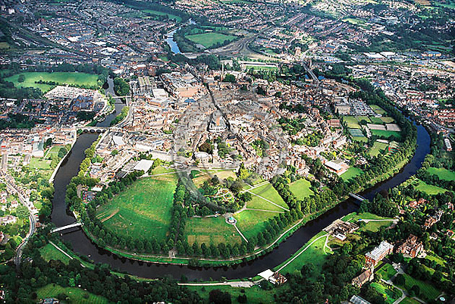
TryPraying Shrewsbury 2016

Slide 2
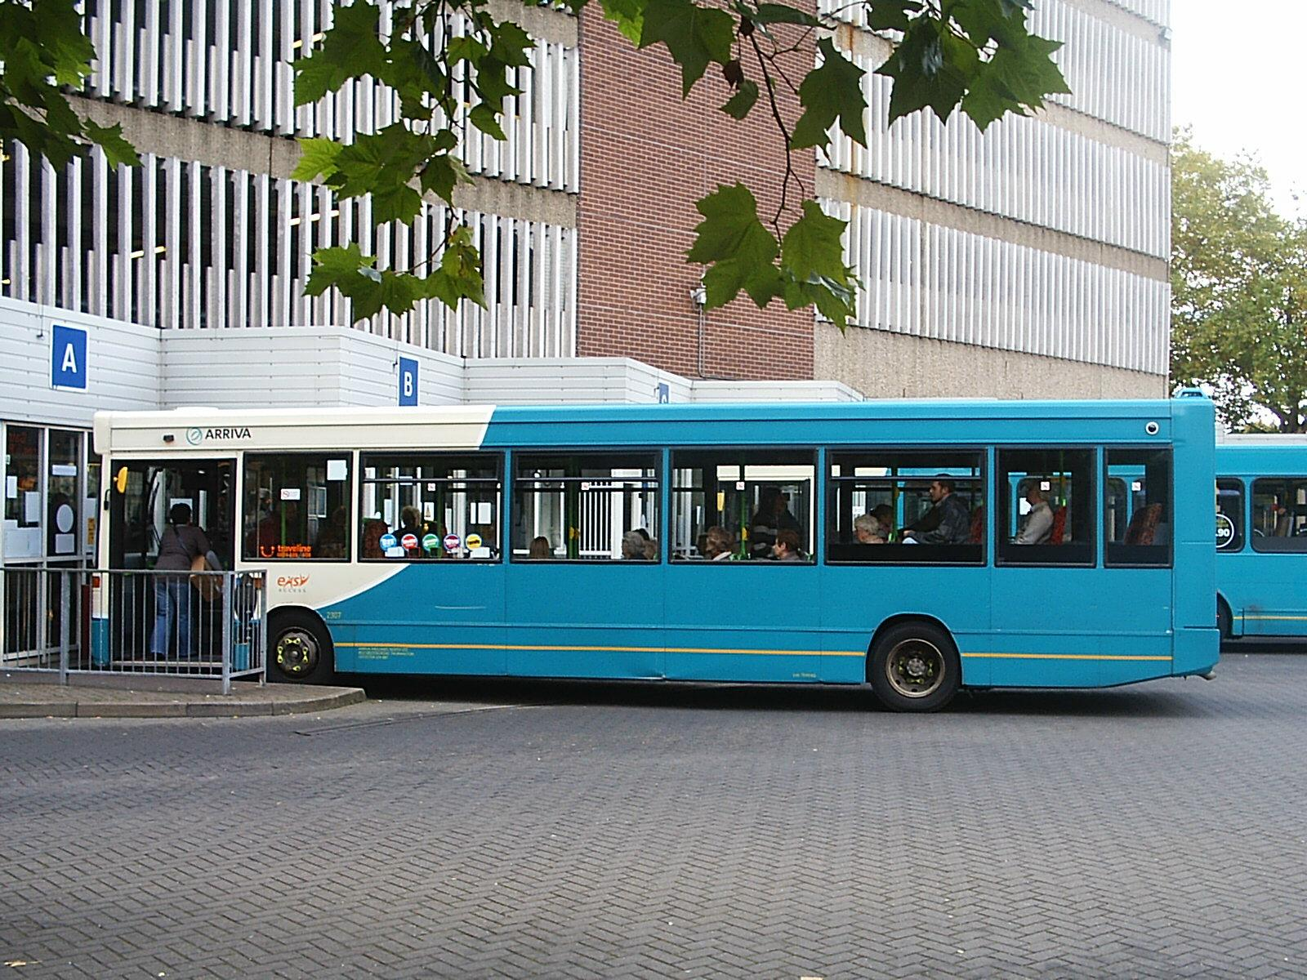


Slide 3
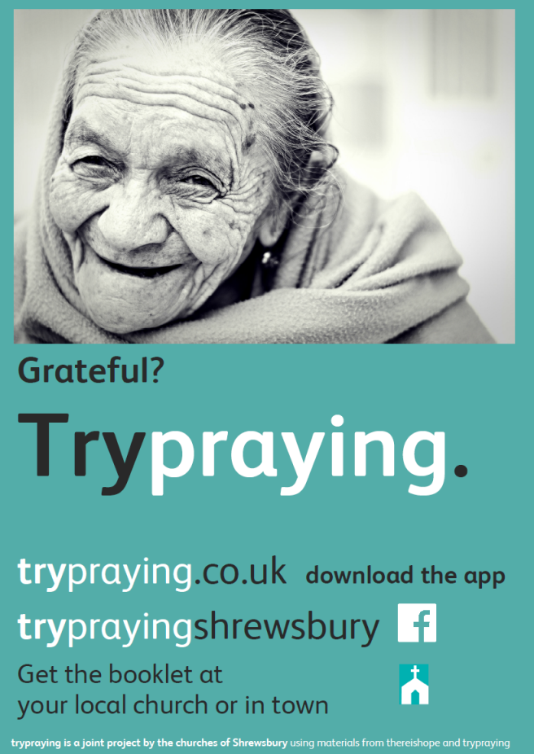
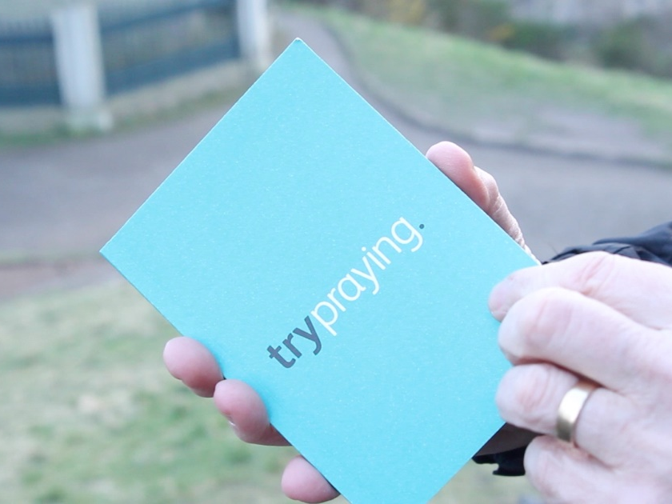
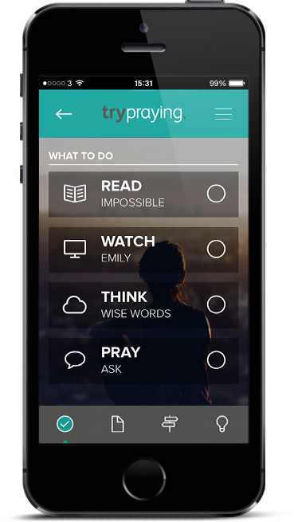

Slide 4


Shrewsbury
Nearly 5000 ‘credit cards’ given out
Similar number of TryPraying booklets
Facebook reach 16,885 people in April (1100 reactions – ‘likes’ etc.)
308 conversations about prayer recorded (we think there were many more!)
Some lovely stories
What next?
We keep praying
(meeting every fortnight)

Slide 5
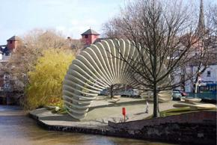
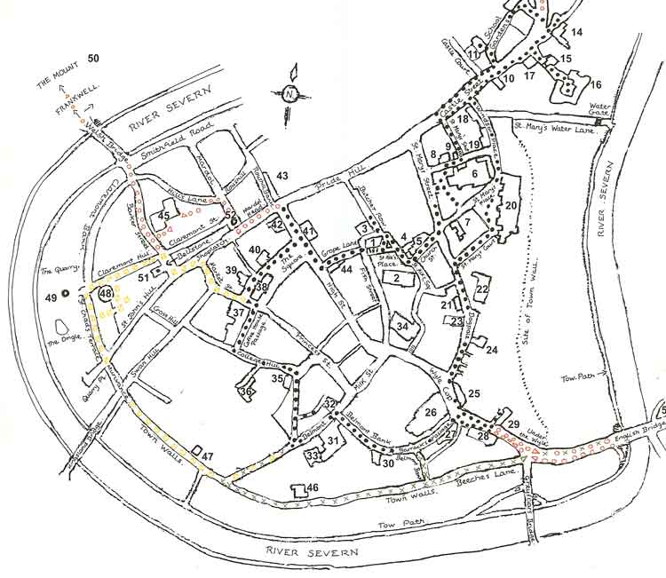
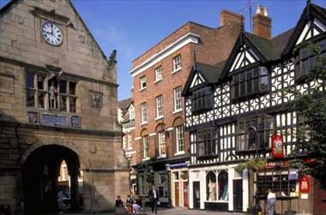
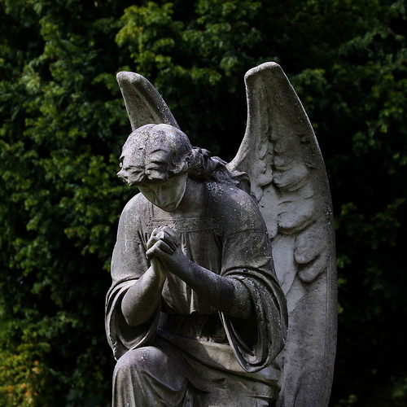
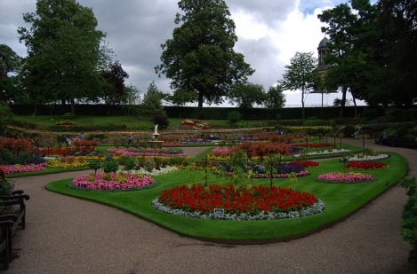
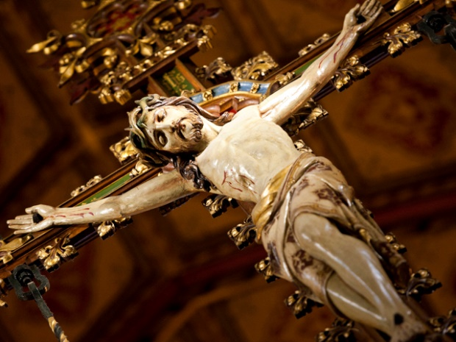
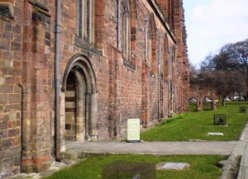
2. Town
Prayer Trail

Slide 6

What is prayer?
3. Times and places to talk about prayer

Slide 7
Shrewsbury
The direction of Christian prayer is an encounter with Jesus, Saviour and Lord.
Please be part of it!

